Slide 1
Reporter assays to understand cell type-specificity
UBDS3 2026
Julia Rühle PhD
Centre for Genomic Regulation, Barcelona

Slide 2


Cell type-specific biology
Background
Where, when and how strongly are genes expressed?
Gene 1
Gene 2
Gene 3
…
Gene 1
Gene 2
Gene 3
…
Red Blood Cell
White Blood Cell
How can we measure this?
Notes:
Cell type-specific biology
Where, when and how strongly are genes expressed.
Because this will eventually decide the cells function and the cell type.
So now if we don’t only think about white and red blood cells, but we think about the whole blood system. There is many many cell types and youre also porbably aware

Slide 3
Blood formation is driven by a powerful stem cell system
Background
100,000 stem cells in humans
One division per ~120 days
Hematopoietic
Stem Cell (HSC)
Lymphocytes
T, B & NK cells
Myeloid Cells
Megakaryocytic-
Erythroid Cells
Eo/Baso & mast cells
Neutrophils
Megakaryocytes
1 trillion (10¹²) new cells
per day
Monocytes
Erythrocytes
Dendritic cells
Notes:
Lymphocytes: adaptive immunity
Myeloid: innate defence, inflammation, antigen presentation
Erythroid: oxygen transcport
However, in contrast to this hierarchical and very stepwise process, hematopoiesis is rather a continuous process.
Transition: Although this diagram depicts a highly hierarchical, stepwise differentiation process, in reality it represents more of a continuum, with stem-like or progenitor cells as well as more differentiated cells distributed along these branches

Slide 4

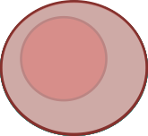
Blood formation is a continuous system
Background
100,000 stem cells in humans
One division per ~120 days
Hematopoietic
Stem Cell (HSC)
Lymphocytes
Myeloid Cells
1 trillion (10¹²) new cells
per day
Erythroid Cells
(Velten, Nature Cell Biology, 2017)
(Laurenti & Göttgens, Nature, 2018)
Notes:
To understand the whole continuum, we have to understand how decisions are taken so how cells if they should become a lymphocyte or a myeloid cell.
Stem cells, multipotent progenitors, more specialised progenitors until terminally differentiated cells.

Slide 5
Blood formation is a continuous system
Background
100,000 stem cells in humans
One division per ~120 days
Hematopoietic
Stem Cell (HSC)
?
Lymphocytes
Myeloid Cells
1 trillion (10¹²) new cells
per day
Erythroid Cells

Slide 6
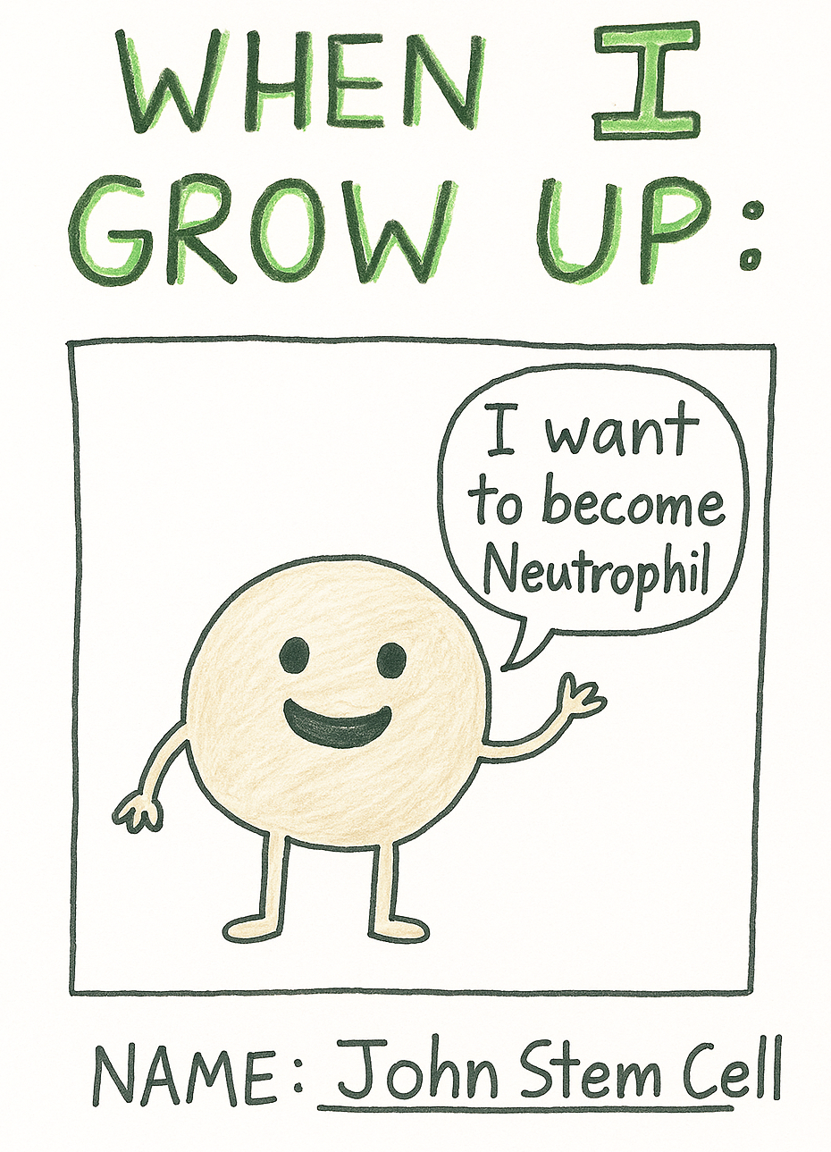
How does the cell know what to become?
Background
Notes:
To understand the whole continuum, we have to understand how decisions are taken so how cells if they should become a lymphocyte or a myeloid cell.
Stem cells, multipotent progenitors, more specialised progenitors until terminally differentiated cells.

Slide 7
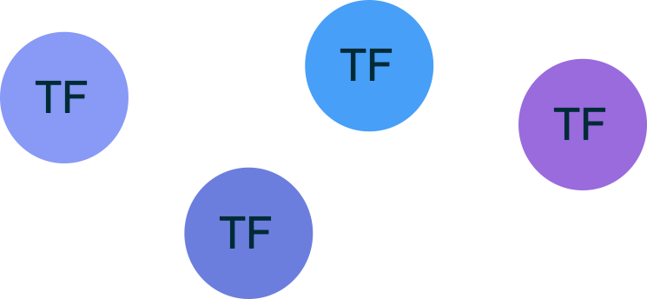
Transcription Factors as drivers of development
Background
100,000 stem cells in humans
One division per ~120 days
Hematopoietic
Stem Cell (HSC)
?
Lymphocytes
Myeloid Cells
1 trillion (10¹²) new cells
per day
Erythroid Cells

Slide 8
Transcription Factors drive cell fate decisions
Background
Cis gene regulation
Lymphocytes
Myelocytes
Erythroid Cells

Slide 9
Transcription Factors drive cell fate decisions
Background
Cis gene regulation
Lymphocytes
Myelocytes
Erythroid Cells
Notes:
I need an analogy for TF binding sites, a bit like a puzzle or so.
So now when we study these TFs in hematopoieis/

Slide 10
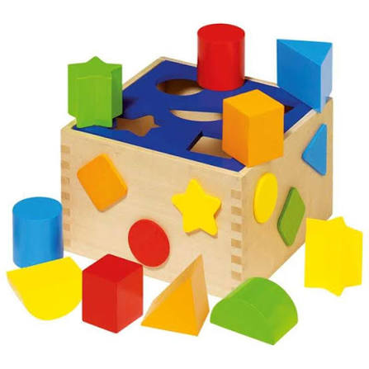
Transcription Factors drive cell fate decisions
Background
Cis gene regulation
Lymphocytes
Myelocytes
Erythroid Cells
What do we find when we study these TFs in hematopoiesis?
Notes:
I need an analogy for TF binding sites, a bit like a puzzle or so.
So now when we study these TFs in hematopoieis/

Slide 11
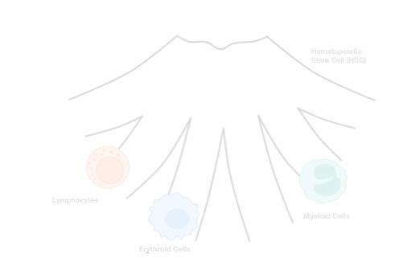
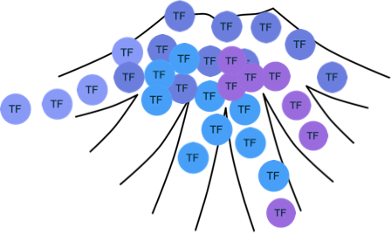
Overlapping gradients of Transcription Factors
Background
What we expect
Reality

Slide 12
Overlapping gradients of Transcription Factors
Background
What we expect
Reality
How can we study TFs and enhancers?
- Genomic readouts
- Computational Inference
- Reporter Assays
~1 trillion (10¹²) new cells per day
Notes:
Where, when and how strongly are genes expressed.
Relevance of enhancers in 2 contests.
Enhancers are drivers of cell fate decisions.

Slide 13
Enhancers regulate cell fate
Background
Massively Parallel
Reporter Assays (MPRAs)
BC
How can we study enhancers?
- Genomic readouts
- Computational Inference
- Reporter Assays
Hypothesis Testing
General Rules of enhancer logic
(Frömel, Rühle et al., Cell, 2025)
Notes:
How can we study enhancers in sufficient detail?

Slide 14
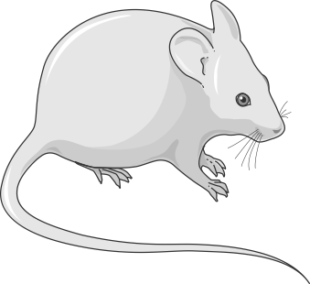
Rules of enhancer logic
Experimental Design
In vitro hematopoietic
differentiation
Simplified
synthetic enhancers
Bulk Lenti MPRA
mHSCs
Infection
Differentiation
FACS

Slide 15
Rules of enhancer logic
Experimental Design
In vitro hematopoietic
differentiation
Bulk Lenti MPRA
mHSCs
enhancers
Infection
Differentiation
FACS

Slide 16
Rules of enhancer logic
Experimental Design
In vitro hematopoietic
differentiation
Bulk Lenti MPRA
Synthetic enhancers
mHSCs
enhancers
Infection
Differentiation
FACS
Why study synthetic enhancers and not genomic enhancers?
Notes:
40 TFs of interest in this differentiation system, highlight novelty of synthetic enhancer design. We can measure what ppl have tried to infer before
1) Endogenous enhancers are somehow similar so we are extending the space
2) Endogenous enhancers are very complicated

Slide 17
Rules of enhancer logic
Designing Synthetic Enhancers
Single-TF

Slide 18
Rules of enhancer logic
Designing Synthetic Enhancers
Single-TF
TF-pairs
40 TFs & ~100,000 sequences
Notes:
More than 60,000 sequences in 7 cell states, you can esign them blablá we looked into the effects of these other features, but the main s oens result from single and parís and nrepetats and affinity, so Will focus on this
1) Endogenous enhancers are somehow similar so we are extending the space
2) Endogenous enhancers are very complicated, so it’s a way to simplify and understand the rules

Slide 19
Rules of enhancer logic
Principles of Enhancer Logic
Single-TF sequences encode broad activity
Activators &
Repressors
Activation
Mechanisms of
cell type-specificity
Repression
Transcription Factors
Notes:
Remove set 2

Slide 20
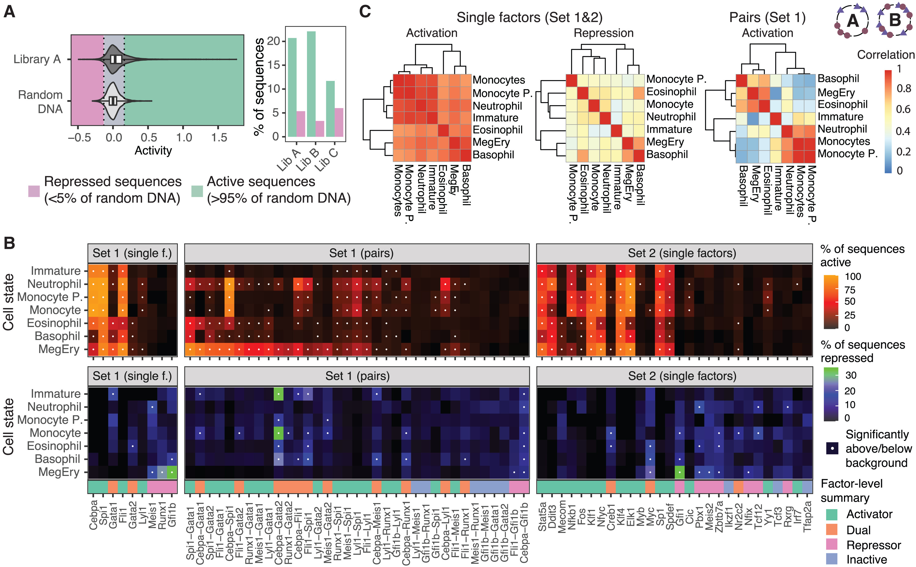
Rules of enhancer logic
Principles of Enhancer Logic
Activators &
Repressors
Pairs of TFs encode cell type specificity
Single-TF
TF pairs
Mechanisms of
cell type-specificity

Slide 21
Rules of enhancer logic
Principles of Enhancer Logic
Activator-Repressor Duality
Activators &
Repressors
Mechanisms of
cell type-specificity
Notes:
Axis labels missing

Slide 22
Single-cell MPRA
From bulk to single-cell: scMPRA

Slide 23
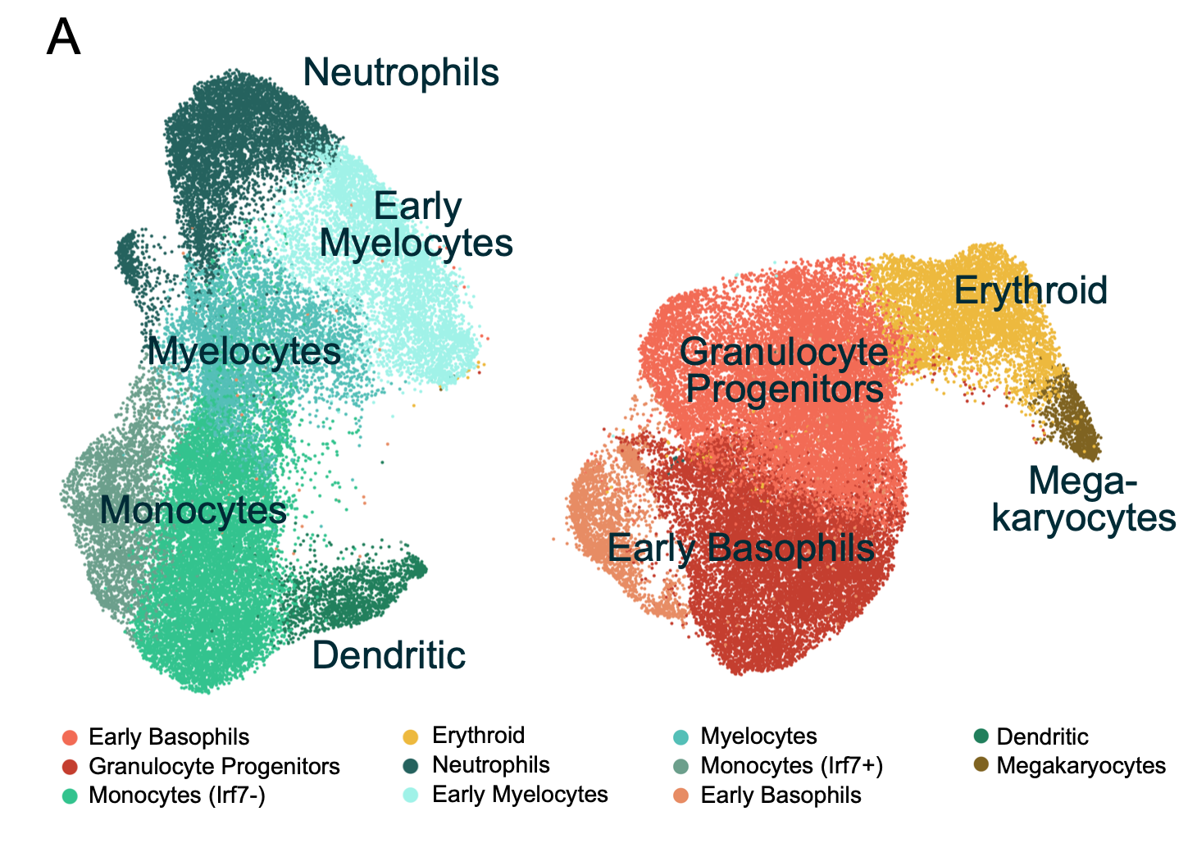
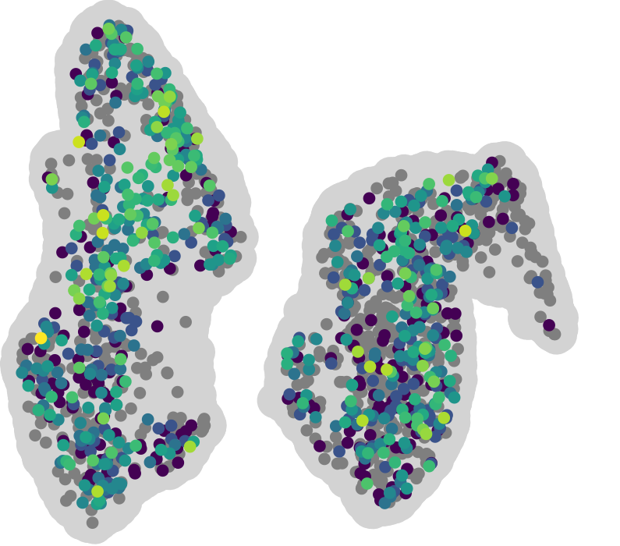
Single-cell MPRA
Enhancer activity at single-cell resolution
Pan-myeloid differentiation
Cebpa enhancer
umap2
umap1
all cells
cells with presence barcode
Activity log(GFP count)
(Rühle et al., Genome Biology, 2026)
Notes:
Grey measurement, detection barcode and not GFP. Thats why this system is good, to have the two barcode. Light grey background. Only cells where we detected. Make clear why there are less points in the ones on the right.

Slide 24
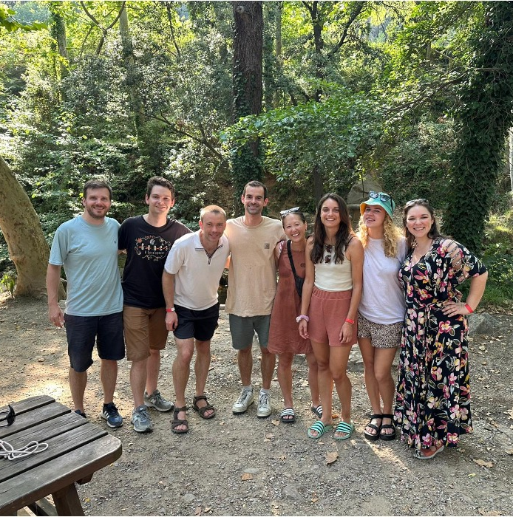
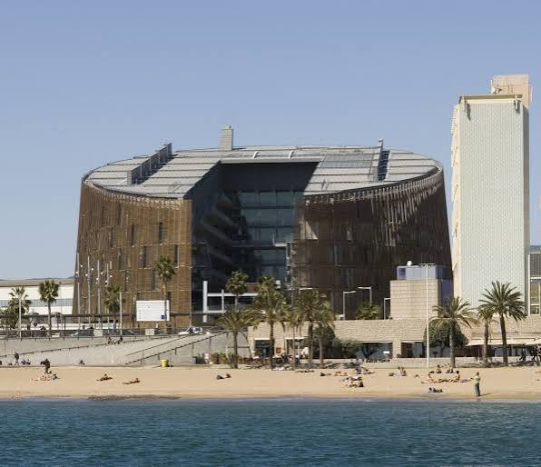




Thanks for your attention
Velten Lab
Lars Velten
Aina Bernal Martínez
Pablo Borredat Díaz
Joseph Bowness
Martina Braun
Jacob Hepkema
Dorothee Mersch
Ana Lopez Garcia
Chelsea Szu Tu
Alumni
Sergi Beneyto Calabuig
Valeriia Dragan
Robert Frömel
Michael Scherer
Genomics Facility
FACS Facility
Treutlein Lab
Barbara Treutlein
Jasper Janssens

